Slide 1
Milestone 2
Abdelrahman Gelany 43-17100
Mohamed Abdelmaksoud 43-16710

Slide 2
These are our
Chosen objects
Object name | Operation | OID | Description
iso.org.dod.internet.mgmt.mib-2 .system.sysDescr | GET | .1.3.6.1.2.1.1.1 | A textual description of the entity. This value should include the full name and version identification of the system's hardware type, software operating-system, and networking software. It is mandatory that this only contain printable ASCII characters.
iso.org.dod.internet.mgmt.mib-2 .System. sysContact | SET | .1.3.6.1.2.1.1.4.0 | The textual identification of the contact person for this managed node, together with information on how to contact this person.
iso.org.dod.internet.mgmt.mib-2 .System.sysLocation | TRAP | .1.3.6.1.2.1.1.6 | The physical location of this node (e.g., `telephone closet, 3rd floor').
iso.org.dod.internet.mgmt.mib-2 .ip. . ipAddrTable. ipAddrEntry.ipAdEntAddr | GETNEXT | .1.3.6.1.2.1.4.20.1.1 | The IP address to which this entry's addressing information pertains.
iso.org.dod.internet.mgmt.mib-2 .system.sysNAME | GET

Slide 3
Operations on local device

Slide 4
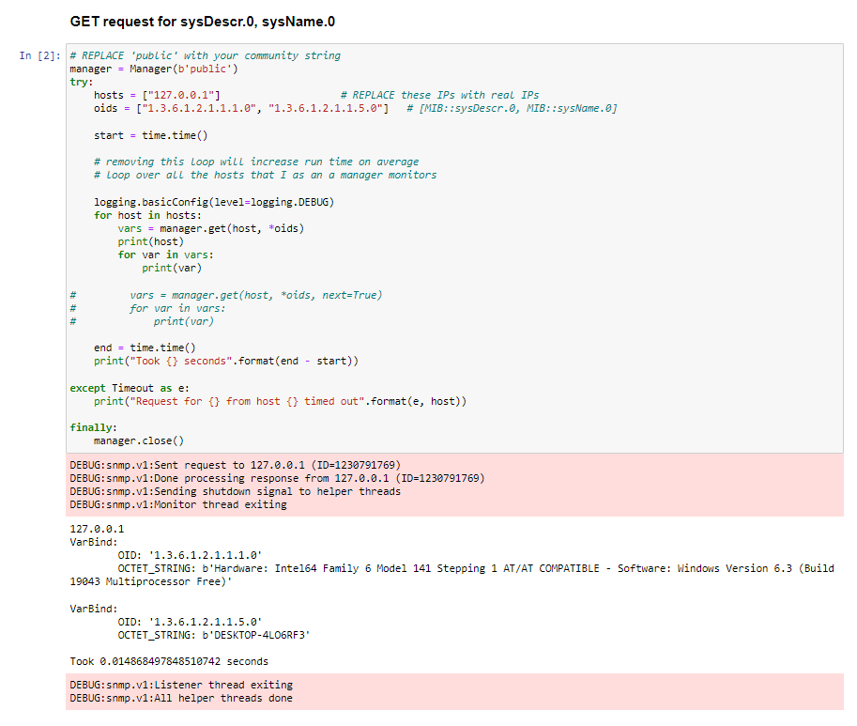
We have developed a python code
For accessing the objects from our local agent.
Here is a snippet from the code for the get method.
Obviously, the ip 127.0.0.1 indicates that we are at local host, the values on the red boxes are the communication messages and logs for the operations.

Slide 5
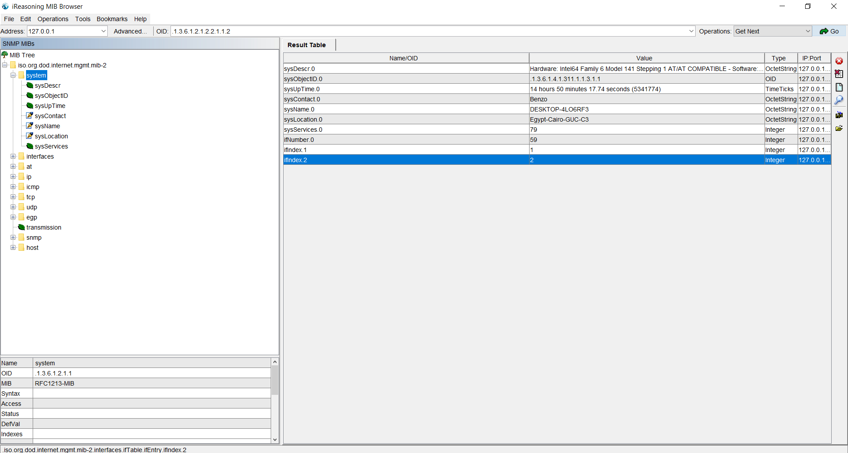
We can notice that values from our code
Are equal to the values from the MIB browser.

Slide 6
Operations for remote Agents

Slide 7
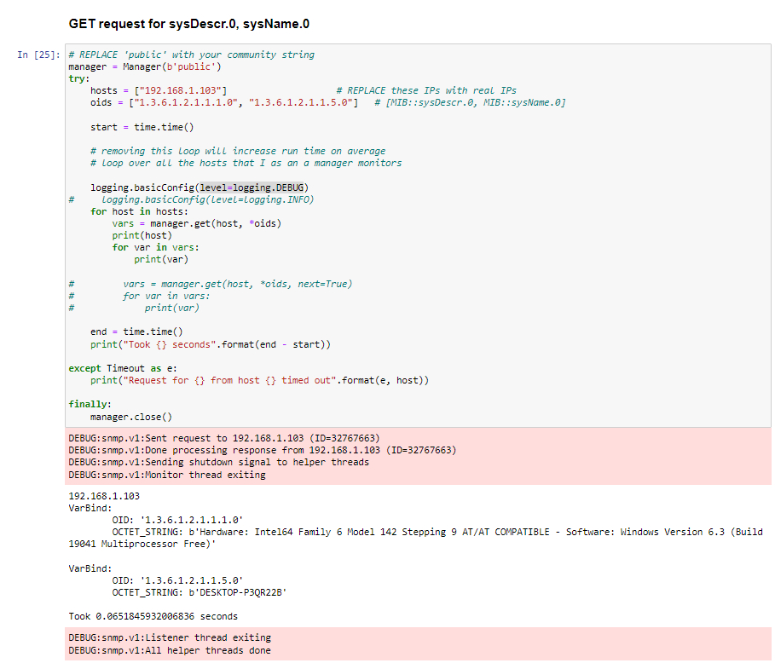
We have used the same code for the remote
Agents, but only changed the ip address to
The address of the agent which is 192.128.1.103.
Here is a snippet from the code for the get method.
Obviously, the ip 192.168.103 indicates that we are
Accessing a remote agent, the values on the red boxes
are the communication messages and logs
for the operations.

Slide 8
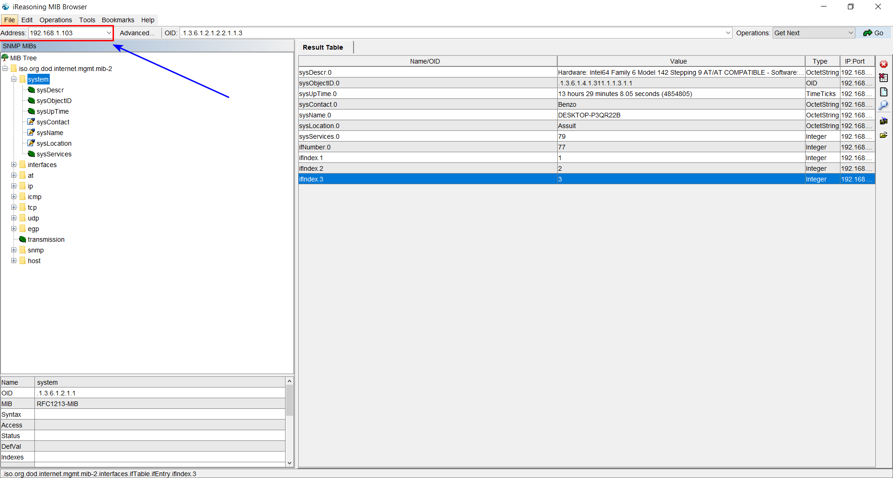
We can notice that values from our code
Are equal to the values from the MIB browser.

Slide 9
Thank you

